Slide 1
Stomp Out Bullying
October, 2016

Slide 2
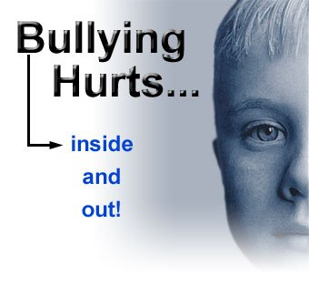
What is bullying?
Bullying is unfair and one-sided behavior.
It happens when someone keeps hurting, frightening, threatening, or leaving someone out on purpose.
There is an imbalance of power.
The mean behavior happens again and again.

Slide 3
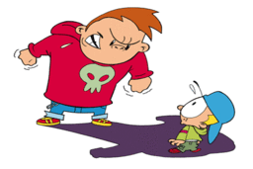
What is bullying?
https://www.youtube.com/watch?v=tYx4CSOtsl0

Slide 4
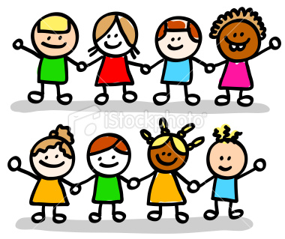
Bystanders can help
https://www.youtube.com/watch?v=eeqQCyQOCPg

Slide 5
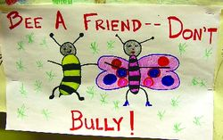
Poster examples

Slide 6
Stand up for one another

Slide 7
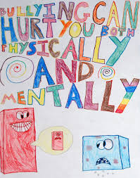
Bullying can hurt

Slide 8
Bullying hurts

Slide 9
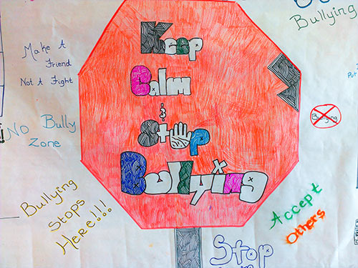
Just say NO

Slide 10
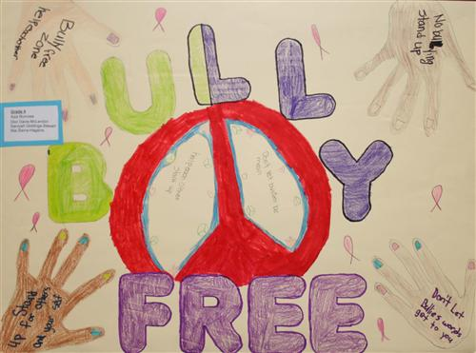
Bully Free Zone

Slide 11
Strategies to Stand Up to Bullying Be an Upstander!
1. Be a buddy- be a friend.
2. Interrupt.
3. Speak Out- “that’s mean. Don’t do that!”
4. Tell an adult.
Be an Upstander and help stomp out bullying!

